Slide 1
CSE514 – Datamining Fall 2022 Knowledge Discovery
Cynthia Ma
Department of Computer Science
Washington University in St. Louis
czma@wustl.edu

Slide 2
Quick Admin Update
Grades for HW1-5, Programming Assignment 1, Exam 1, and Exam 1 EC have been updated with late penalties / regrade changes
Please note that the EC adjustment assignment is meant to enforce the 7.5 upper-bound on EC points for Exam 1
Grades and solutions for HW6 have been posted

Slide 3
Schedule for rest of semester
Mon, Nov 28 (today):
Knowledge Discovery
Wed, Nov 30:
Exam 2 review, PA2 due date
Mon, Dec 5:
Group EC exercise Pt2 for Exam 2
Wed, Dec 7:
Exam 2

Slide 4

Major components of Data Mining systems
Knowledge Base
User Interface
Processed Data
Data Warehouse
Data Mining Engine
Learned Model
Pattern Evaluation
Cleaning
Selecting
Transforming
Raw Data
Data Warehouse

Slide 5
Knowledge Discovery from Data (KDD)
Data cleaning
Data integration
Data selection
Data transformation
Data mining
Pattern evaluation
Knowledge presentation

Slide 6
Pre-processing
Data cleaning: where noise and and inconsistent data is removed
Data integration: where data from multiple sources is combined
Data selection: where data relevant to the analysis task are retrieved from database
Data transformation: where data are transformed and consolidated into forms appropriate for mining

Slide 7
Data mining
Where intelligent methods are applied to extract data patterns
Data patterns can be:
Descriptive(서술):
Data characterization: summarize target class in general terms
Data discrimination: comparison of target class with contrasting class(es)
Predictive(예측):
Classification: finding a model that can predict class labels
Regression: finding a model that can predict numerical values

Slide 8
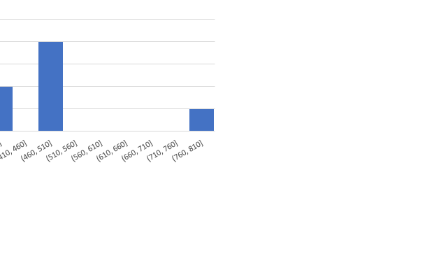
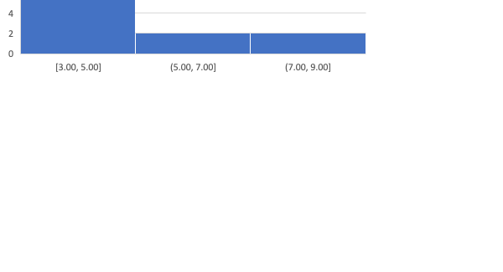
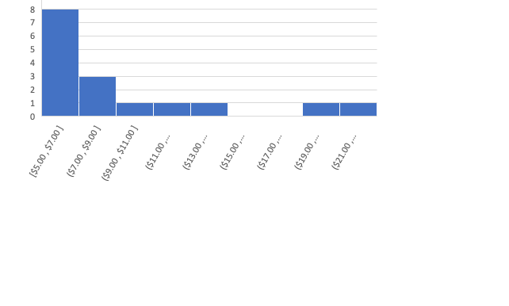
Data characterization example: Asian lunches

Slide 9
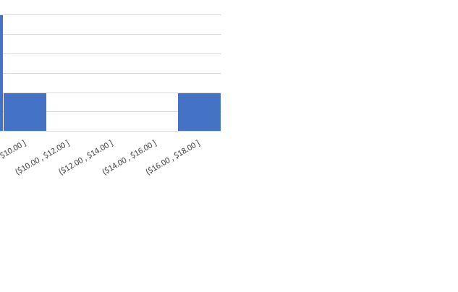
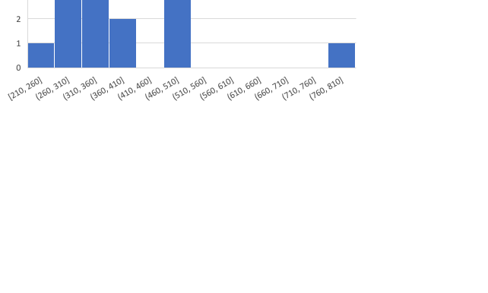
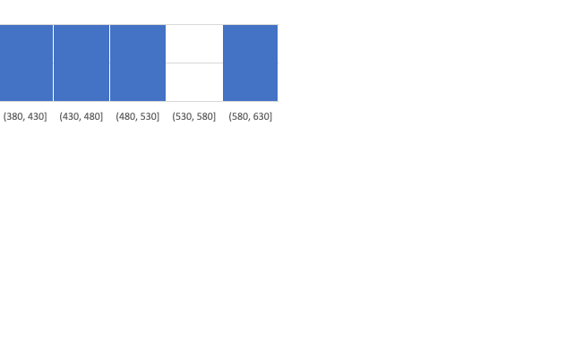
Data discrimination example: Asian lunches vs. American lunches

Slide 10
Post-processing
Pattern evaluation: where “interestingness” measures are applied to identify the truly interesting patterns
Knowledge presentation: where visualization and representation techniques are used to present mined knowledge to users

Slide 11
Defining a pattern as “interesting”
Easily understood by humans
Valid on new / unseen data with some degree of certainty
Potentially useful / actionable
Novel
Validates a hypothesis
Relevant for explaining large percentages of data
Notes:
Easily understood by humans, 문제 suggest an object measure => low dimensionality 일수록 사람이 인지하기 쉽다
Valid on new data with some degree of certainty, 문제 suggest an objective measure => accuracy on testing data
Potentially useful: 문제 suggest an object measure => difference in profit gained by using new insight

Slide 12
General Challenges
Mining methodology
User interaction
Efficiency and scalability
Diversity of data types
Data mining and society

Slide 13
Mining methodology
The kinds of data and the kinds of applications for data continue to grow
Interesting patterns can be searched for among varying combinations of dimensions, at varying levels of abstraction
Data mining can often benefit from incorporation of field specific knowledge
A "networked” environment can allow knowledge derived in one set to boost knowledge in another
Subjective priorities for pre- and post- processing

Slide 14
User interaction
Data mining is an iterative process and therefore highly interactive between user and database
Background knowledge of user can have large impact on approach
Database query languages and interfaces must balance the goals of flexibility, clarity, and security
Presentation and visualization of results must enable easy understanding by humans, as well as facilitate use of knowledge

Slide 15
Efficiency and scalability
As the amount of collectable data grows, data mining approaches must be able to scale, up to the point of executing in real time
Algorithms should be parallel, distributed, and incremental
Cloud computing and cluster computing are powerful options for handling large-scale computational tasks

Slide 16
Diversity of data types
Complex types of data include temporal data, biological sequences, multi-media data, social network data, etc…
Expecting a single system to handle all data types is unrealistic, so domain- or application- dedicated systems are constructed instead
Multiple sources of data that are connected by the internet or other networks form gigantic heterogeneous information systems with diverse data semantics that can be more informative than the individual sources

Slide 17
Data mining and society
Social impacts:
How to use data mining to benefit society?
How to guard against mis-use?
Privacy preservation:
To what extent can we preserve individuals’ privacy while still performing successful data mining?
“Invisible” integration:
Not everyone will learn data mining techniques, but everyone can benefit. How and where can we build in data mining functionality?

Slide 18
Homework
HW 7 deadline is midnight today
Programming Assignment 2 is due Wed, Nov 30

